Slide 1
Getting Groovy with Jenkins

Slide 2
So what is Jenkins Pipeline?
https://github.com/jenkinsci/workflow-plugin/blob/master/TUTORIAL.md
Built with the community’s requirements for a flexible, extensible, and script-based CD pipeline capability for Jenkins in mind. To that end, Pipeline:
Can support complex, real-world, CD Pipeline requirements: pipelines can fork/join, loop, parallel, to name a few
Is Resilient: pipeline executions can survive master restarts
Is Pausable: pipelines can pause and wait for human input/approval
Is Efficient: pipelines can restart from saved checkpoints
Is Visualized: Pipeline StageView provides status at-a-glance dashboards including trending

Slide 3
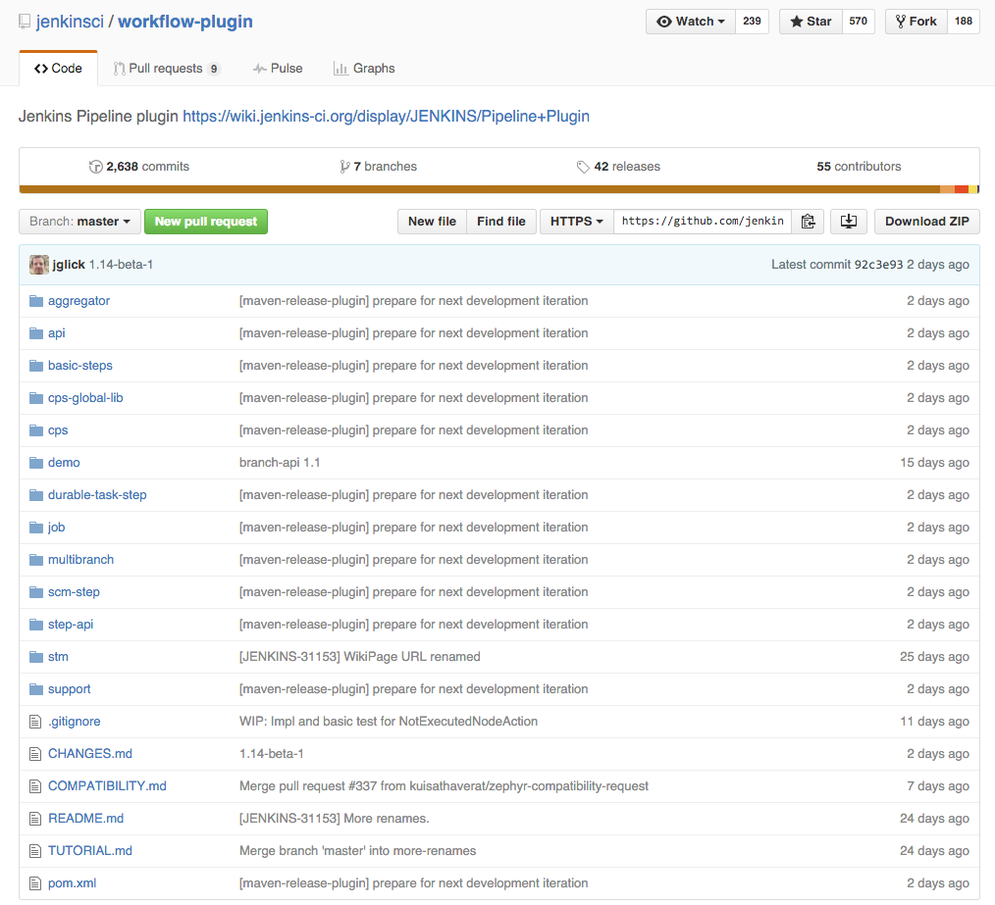
Its just a plugin!
https://github.com/jenkinsci/workflow-plugin

Slide 4
What does it give you?
https://dzone.com/refcardz/continuous-delivery-with-jenkins-workflow

Slide 5
Basic Building Blocks

Slide 6
Used to mark a phase in the pipeline
step "package"

Slide 7
Specifys that this bit should run on a jenkins
slave that has the word “unix” in its name
step "package"
node("unix") {
}

Slide 8
step "package"
node("unix") {
git url: "https://github/project.git
}
Checkout some code

Slide 9
step "package"
node("unix") {
git url: "https://github/project.git
sh("mvn clean package")
}
Run a shell command

Slide 10
step "package"
node("unix") {
git url: "https://github/project.git
sh("mvn clean package")
stash includes: "target/artifact.jar" name "artifact"
}
Store a file for later use

Slide 11
step "package"
node("unix") {
git url: "https://github/project.git
sh("mvn clean package")
stash includes: "target/artifact.jar" name "artifact"
}
node("unix") {
unstash name: "artifact"
sh("cf push -n artifact.jar")
}
Do some more stuff on a different slave (or the perhaps the
same slave – who knows?)

Slide 12
Gotchas

Slide 13
Gotchas
Serialisation
Since pipelines must survive Jenkins restarts, the state of the running program is periodically saved to disk so it can be resumed later (saves occur after every step or in the middle of steps such as sh).
The “state” includes the whole control flow including: local variables, positions in loops, and so on. As such: any variable values used in your program should be numbers, strings, or other serializable types, NOT “live” objects such as network connections.
Example. Copied ConfigSlurper ConfigObject to HashMap because HashMap is serialisable.

Slide 14
Further Gotchas
https://github.com/jenkinsci/pipeline-examples/blob/master/docs/BEST_PRACTICES.md
Don’t have the Groovy interpreter making blocking i/o calls, i.e., HTTPClient and the like - these can cause real problems with resumability, and also require a lot of explicit whitelisting of methods in the Script Security plugin, which is not ideal. (hint. Just use curl!)
Beware for (Foo f: foos) loops and Groovy closure-style operators like .each and the like. They will not work right in normal Workflow script contexts where Workflow steps are involved directly.
If you need to do that kind of thing to make your scripting make sense, do it in methods annotated with @NonCPS. These methods will not be CPS-transformed, so can do some things that just can't be done in the serializable/resumable CPS context.
Don’t use the Groovy scripting in place of shell scripting - work coming for the ability to run a Groovy step on the node as with the normal Groovy plugin build step, but until then, shell out, even if it’s just to do sh 'groovy foo.groovy’.
Don’t use varargs in your methods (found this one out the hard way yesterday ☹)

Slide 15
So I have my pipeline as code… Now what?

Slide 16
Reusable Libraries
node() { git poll: false, changelog: false, url: workflowLibsRepo, credentialsId: gitCredentialsIdForWorkflowLibs, branch: branch common = load "lib/common.groovy" common.assertMandatoryParameters(parameters) common.logParameterValues(parameters) }
node() { git poll: false, changelog: false, url: workflowLibsRepo, credentialsId: gitCredentialsIdForWorkflowLibs, branch: branch cf = load "lib/cf.groovy” cf.mapRoute(appName, majorHostName, cfSpace, cfOrg, cfApiEndpoint, pcfCredentialsId) }

Slide 17
Testing
Given that workflow is just a groovy DSL we can provide a different Script Base Class that allows us to test.
public static final String SCRIPT_NAME = "lib/cf.groovy" def GroovyShell shell def cf def common def errors = [] def shellCommands = []
@Before void setUp() { def CompilerConfiguration compilerConfiguration = new CompilerConfiguration() compilerConfiguration.scriptBaseClass = new WorkflowStub().getClass().getCanonicalName() def Binding binding = new Binding() shell = new GroovyShell(this.class.classLoader, binding, compilerConfiguration) common = new Object() cf = shell.evaluate(new File(SCRIPT_NAME)) cf.common = common cf.metaClass.error = { String s -> errors.add(s) } cf.metaClass.sh = { String s -> shellCommands.add(s)} }

Slide 18
Branching
pull request

Slide 19
When you hit something that Workflow can’t do
Write a utility
common = load "lib/common.groovy" nexus = load "lib/nexus.groovy" def callCfManifestParser(args){ def fileName = "cf-manifest-parser.jar" nexus.fetch(fileName, "snapshots", "cf-manifest-parser", "com.wiprodigital") common.readResult("java -jar ${fileName} ${args}") }

Slide 20
Jenkins Enterprise – worth it?
https://www.cloudbees.com/products/cloudbees-jenkins-platform/enterprise-edition/features
Restart builds from checkpointed locations on master and slave failures with the Checkpoints plugin
Easier navigability across chained jobs with Consolidated Build View plugin
Reuse best practices with the Templates plugin

Slide 21
Demo

